Slide 1

DON BOSCO INSTITUTE OF TECHNOLOGY
Department of Electronics and Telecommunication
Design And Development Of
UNDERWATER VEHICLE
Project Group Members
06 Justine Ayroor
15 Suman Deb
16 Meghraj Deore
60 Akash Sinha
Project Guide:
Ms. Madhavi S. Pednekar
Mr. Iqbal Hadis
1

Slide 2
CONTENTS
No. | Index
1. | Motivation
2. | Project Objective
3. | Literature Survey
4. | Problem Definition
5. | Specifications
6. | Methodology
7. | Analysis and Indigenous Design
8. | Hardware Circuit
9. | Timeline
10. | References

Slide 3
MOTIVATION
To contribute in “MAKE IN INDIA”.
Under water control system at college level.
To carry out submarine operation at minor scale with low cost.

Slide 4
OBJECTIVES
To design and develop Underwater Vehicle(UV) using Static Diving Technique. Movement of UV will be controlled by thrusters and propeller with the help of embedded systems.
Notes:
To dehydratre food items faster than commercial solar dyer available in market.

Slide 5
LITERATURE SURVEY
Title : “RFID Under Water: Technical Issues and Applications”
Learning: The chemical composition of marine water is influenced by several
biological, chemical and physical factors and thus due to this large
attenuation of signals takes place as compared to the air medium.
δ= 1
π. f .µ. σ
f= 1 = 75MHz
π x δ² x4πx10⁻⁷x3x10⁻³
Where, δ :- Skin Depth is assumed to be 1m.
Thus, Frequency of operation=75Mhz
Authors :
Giuliano Benelli and Alessandro Pozzebon -University of Siena,
Department of Information Engineering, Siena, Italy

Slide 6
LITERATURE SURVEY
Title : “ Underwater Radio Communication ”
Learning:
Attenuation of radio waves in water:-
Attenuation (α) in dB/metre = 0. 0173 √(fσ)
where, f = frequency in hertz and
σ = conductivity in mhos/metre
Refraction loss (dB) = - 20 log {(7.4586/106) x √(f/σ)
Wavelength (λ) in meters = 1000 √{10/(fσ)}
Authors:
Lloyd Butler, Moore, Richard R. Radio Communications in the Sea, IEEE Spectrum, Vol 4, Nov 1967.

Slide 7
LITERATURE SURVEY
Title : “Electromagnetic Wave Propagation into freshwater”
Learning: The transmission loss is due to the reflection at the air-water interface .
The incident power is written as:
P_{i} = Re |E_{i}|²
2η
where, η:- Intrinsic impedance of water.
E_{i}:- Incident Electric Field.
Transmitted power in water is written as:
P_{t}=Re |E_{t}|²
2 η_{t}
where, η:- Intrinsic impedance of air.
E_{t}:- Transmitted Electric Field.
Authors:
Shan Jiang, Stavros Georgakopoulos
Journal of Electromagnetic Analysis and Applications, 2011,
3,261-266

Slide 8
LITERATURE SURVEY
Title : “Submarine Main Ballast Tanks- Theory And Methods For Refined Structural Design ”
Learning:
Types of Ballast Tank’s designing and operation:-
Action of water required to submerge the underwater vehicle.
Authors: C.H.Pohler, D.S.Wilson, W.A.Skinner
Head Submarine Structural Mechanic Unit, Scientific And Research Section Of The Full System, NAVSEC, Bureau Of Ships.
Commander, US-NAVY, Submarine Project Coordinator.

Slide 9
LITERATURE SURVEY
Title : “AUTONOMOUS UNDERWATER VEHICLES ”
Learning:
Designing of Outer body of the Underwater Vehicle.
Highest Power consumption components in the vehicle
Propellers:- For each of them, the thruster has a working
voltage of 11.2V and 3.5A current drain.
Servo motor:- IT can work under 5V with relatively small current.
Therefore, we use two 3-cells LiPo batteries as the power supply
for the propellers.
Authors:
Nuno A. Abreu, N., Matos, A., Ramos, P. & Cruz, N. (2010). Automatic interface for AUV mission planning and supervision.

Slide 10
LITERATURE SURVEY
Title : “Aspects of Propeller Developments for a Submarine ”
Learning:
Design Considerations for propeller
Orthogonal blade length
RPM
Diameter
Material
Authors:
Poul Andersen1, Jens J. Kappel2, Eugen Spangenberg3
Carlton, J. (2007). Marine Propellers and Propulsion,
Ross, D. (1987). Mechanics of Underwater Noise.

Slide 11
LITERATURE SURVEY
STATIC DIVING TECHNIQUE:-
Static Diving Underwater Vehicle ( UV ) have some means of changing the weight of the UV such as by filling ballast or dive tanks with water . This assists them in submerging . To return to the surface the vehicle dumps the water outside the ballast tank in order to regain bouyancy and return to the surface. Static diving systems may use electric motors, pumps or some form of compressed gas to fill or empty the ballast tanks.
BALLAST TANK:-
A ballast tank is a compartment within a boat , ship or other floating structure (for our case UV) that holds water, which is used as ballast to provide stability for a vessel. Using water in tank allows for easier adjustment of weight than stone or iron ballast as was used in older vessel . It also allows for ballast to be pumped out to temporarily reduce the draft of the vessel when required to enter shallow water.

Slide 12
PROBLEM DEFINITION
To implement a low cost, high range miniature underwater vehicle.

Slide 13
SPECIFICATIONS
Operating Depth(Underwater): 0 – 1.5 Meters
Maximum Velocity: 1.8Kmph(0.5m/s)
Frequency of operation: 75MHz
No. of channels required(Transmitter-Receiver): 6
Range Of Operation: 25m
Camera Quality: 320x240 pixel Resolution
Power supply: 2200 MAh , 12v

Slide 14
METHODOLOGY:
Basic Block
TRANSMITTER
(6 CHANNEL)
75MHZ
Servo
Motor
Rudder
RECEIVER
Syringe
Stepper
Motor
Stepper Motor Driver
(A4988)
Electronic
Speed
Control
(ESC)
Propeller
(BLDC motor)
Arduino
Syringe
Stepper
Motor
Stepper Motor Driver
(A4988)
POWER SUPPLY
LiPo Battery
(2200mAh 12v)

Slide 15
METHODOLOGY: FLOW DIAGRAM
REMOTE
(TRANSMITTER)
R
E
C
E
I
V
E
R
DC POWER SUPPLY
ESC’s
PROPELLER
SERVO MOTOR
ARDUINO
BALLAST TANK
STEPPER MOTOR
Stepper Motor Driver
(A4988)
Stepper Motor Driver
(A4988)
STEPPER MOTOR
BALLAST TANK
SYRINGE
SYRINGE
SYRINGE
SYRINGE
RUDDER

Slide 16
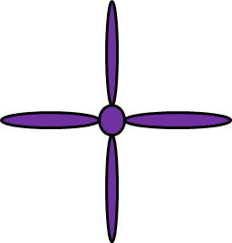

methodology
RUDDERA
CAM
RX
ESC
POWER
supply
BLDC
MOTR
BALLAST TANKz
STEPPER MOTOR
SMD
SMD
STEPPER MOTOR
SYRINGE
ARDUINO

Slide 17
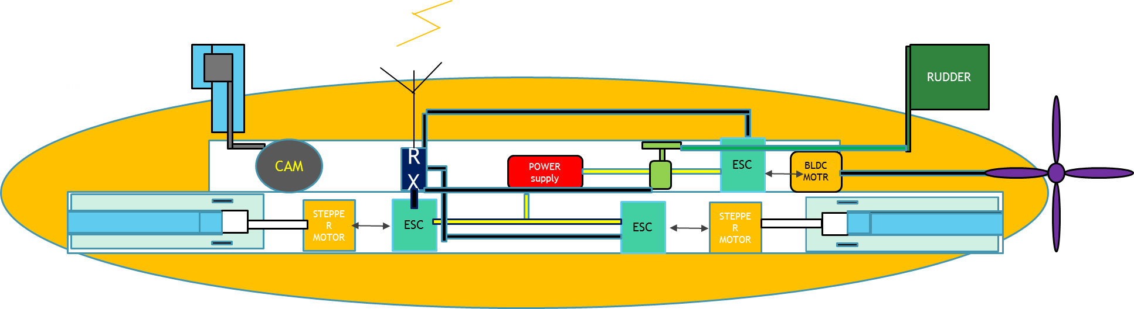
REMOTE
(TRANSMITTER)

Slide 18
REMOTE
(TRANSMITTER)

Slide 19
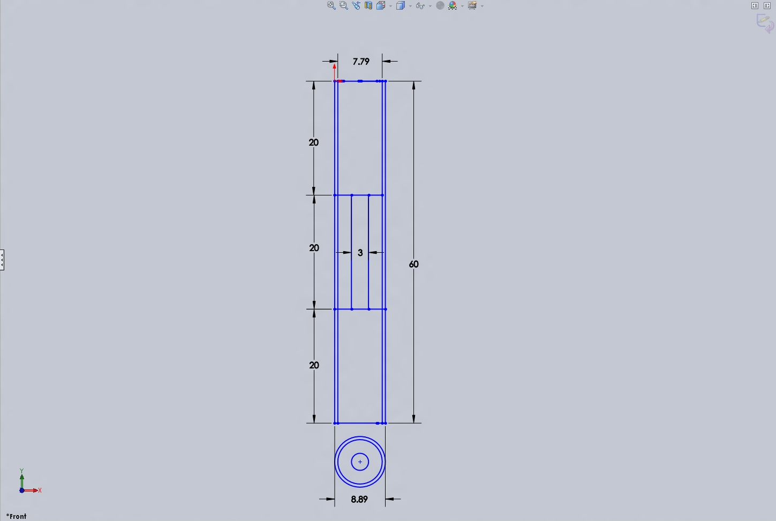
DESIGN: Internal Body
All dimension are in cm.

Slide 20
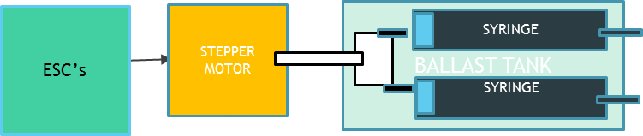
Analysis and Indigenous Design
Syringe Ballast System :-
At the bottom of the UV we have placed two syringes which are controlled using stepper motor. The volume of water filled inside the syringe ballast system determines the depth upto which the UV can submerge which is controlled by us.

Slide 21
APPROACH FOR PROBLEM SOLVING
Calculation for Ballast Tank Volume :
The approach is to figure out how much ballast tank water we need:
To float
UV weight< weight of water displaced by UV
To sink
UV weight > weight of water displaced by UV
WS = Dry weight of the UV(empty ballast tank)
WWD= Weight of water displaced by the UV
WB= Weight of ballast
So neutral buoyancy is when,
WS+WB = WWD
Hence, WB=WWD-WS
Negative buoyancy(TO SINK)
WB<WWD-WS
Convert the weight of ballast tank in terms of liters or cc and we get the volume of water required in the
Ballast tank to sink the vehicle underwater

Slide 22
APPROACH FOR PROBLEM SOLVING
Select the Frequency of operation Underwater:
RFID like all radio-technologies is not suitable to work in presence of water
Electromagnetic waves cannot travel through electrical conductors: this
means that in most cases radio waves cannot be used to communicate under water.
Anyway, studies have proven that the chance to transmit radio signals under water mainly
depends on two factors:
→the conductivity of water
→the frequency of the radio wave.
While the conductivity of water is a factor that cannot be modified to increase the possibility to use
radio waves under water, the only factor that can be modified to increase the performances
is obviously the radio frequency
This factor has already been employed when using the electromagnetic fields for the common
radio transmissions:
Very Low Frequency radio waves (VLF – 3-30kHz) have proven to be able to penetrate sea water
to a depth up to 20 meters,
while Extremely Low Frequency radio waves (ELF - 3-300Hz) can travel in sea water up to
hundreds of meters.
only two RFID technologies can be employed for underwater applications:
the High Frequency systems, operating at 13.56MHz
the Low Frequency systems, operating in the 125-134kHz band.
For this UV Frequency of Operation is 75Mhz which should be able to penetrate a few meters in water

Slide 23
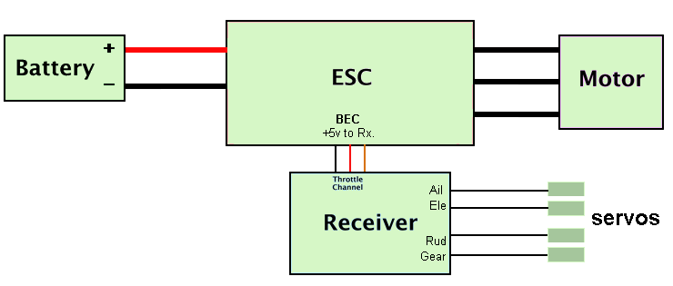
HARDWARE CIRCUIT

Slide 24
TIMELINE
WEEK | JOB
August 1st week | Idea & the proposal of the topic.
August 2nd week | Research & presentation on the topic.
August 3rd week | Literature survey.
August 4th week | Dimensions & calculations regarding vehicle.
September 1st week | Antenna research(underwater).
September 2nd week | Testing of frequency suitable for underwater transmission.
September 3rd week | Designing & purchasing basic parts.
September 4th week | Working on ballast tank.
October 1st week | Working on ballast tank.
October 2nd week | Working on ballast tank.
October 3rd week | Positive and negative buoyancy of the vehicle.
October 4th week | Movement of vehicle inside water.

Slide 25
REFERENCE
RFID Under Water: Technical Issues and Applications:
Giuliano Benelli and Alessandro Pozzebon -University of Siena,
Department of Information Engineering, Siena, Italy
Underwater Radio Communication:
Shan Jiang, Stavros Georgakopoulos
Journal of Electromagnetic Analysis and Applications, 2011,
3,261-266
Electromagnetic Wave Propagation into freshwater
Shan Jiang, Stavros Georgakopoulos
Journal of Electromagnetic Analysis and Applications, 2011,
3,261-266
Submarine Main Ballast Tanks- Theory And Methods For Refined Structural Design
C.H.Pohler, D.S.Wilson, W.A.Skinner
Head Submarine Structural Mechanic Unit, Scientific And Research Section Of The Full System, NAVSEC, Bureau Of Ships.
Commander, US-NAVY, Submarine Project Coordinator.

Slide 26
REFERENCE
AUTONOMOUS UNDERWATER VEHICLES
Nuno A. Cruz , Abreu, N., Matos, A., Ramos, P. & Cruz, N. (2010). Automatic interface for AUV mission planning and supervision.
Aspects of Propeller Developments for a Submarine
Poul Andersen1, Jens J. Kappel2, Eugen Spangenberg3
Carlton, J. (2007). Marine Propellers and Propulsion,
Ross, D. (1987). Mechanics of Underwater Noise.

